Slide 1



Cafe Management System
PRESENTED BY:-
ABHILASH DAS-230720100017
GUIDED BY:-
Swarupa Pattnaik

Slide 2

Content
Introduction
Objective
Software & Hardware Requirements
Flow process

Slide 3

Introduction :-
Café Management System is an application, which will help restaurants /cafés to optimize and control over their restaurants and cafés menu. This application helps the cafés to do all functionalities more accurately and efficiently. Café Management system reduces manual work and improves efficiency and rate of work. It is specifically designed for café billing management and order taking management system. This software helps to take food orders and display them. Also, help to maintain records in system and display total sale report. It is keeping a proper record of the bills.

Slide 4



Objective
The project aim and objectives that we will achieve after the completion of this project are :-
1)To take orders
2)To add item
3)To display menu
4)To show bill
5)To display total sale reports

Slide 5


Requirements
Hardware Requirement
Software Requirement
Laptop :
HDD: 250gb onwards
VS CODE
OS-WINDOWS 11
RAM: 2GB onwards
PROCESSOR: intel i5
onwards

Slide 6
Flow Process :
START
DEFAULT
LOGIN
SNACKS
END
BEVERAGES
SWITCH
T
FOR
F
BILLING

Slide 7
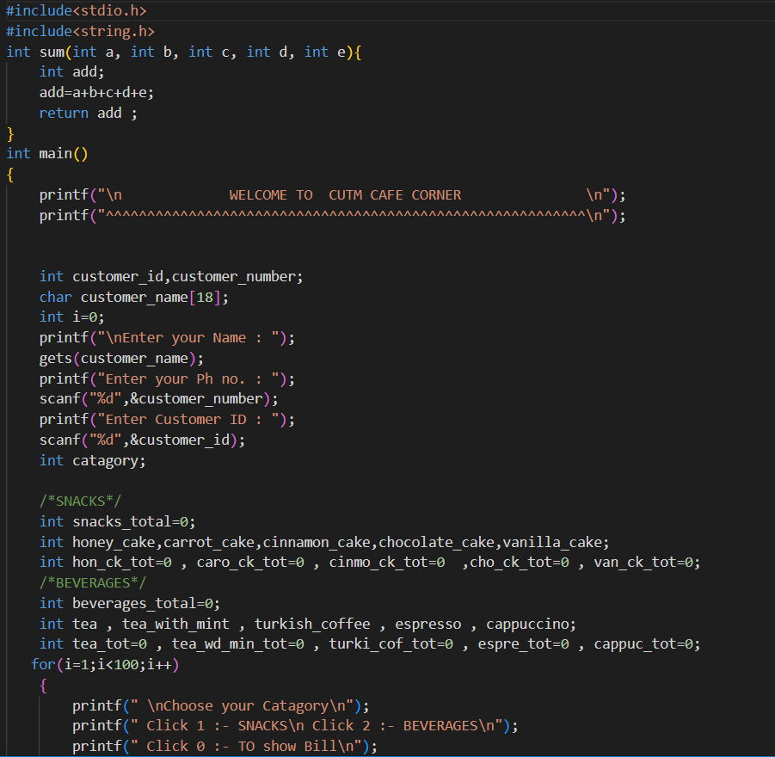
PROJECT
CODE :-

Slide 8
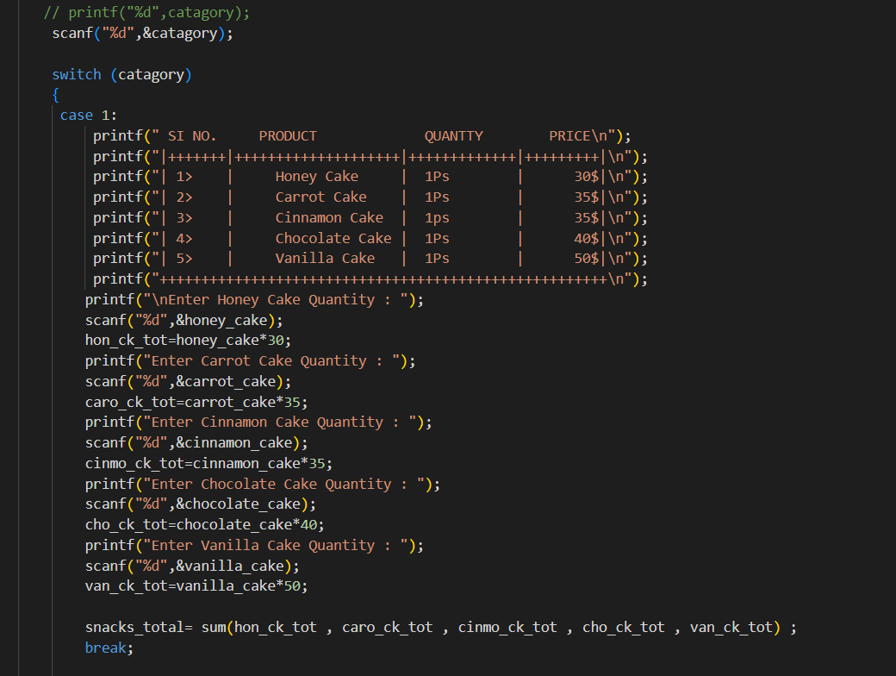
CONT :-

Slide 9
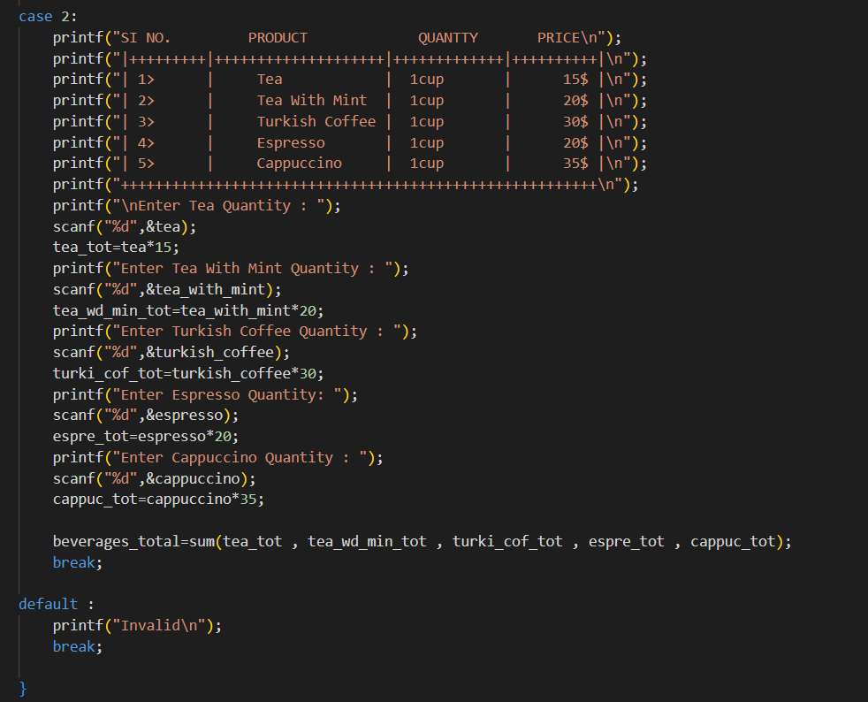
CONT :-

Slide 10
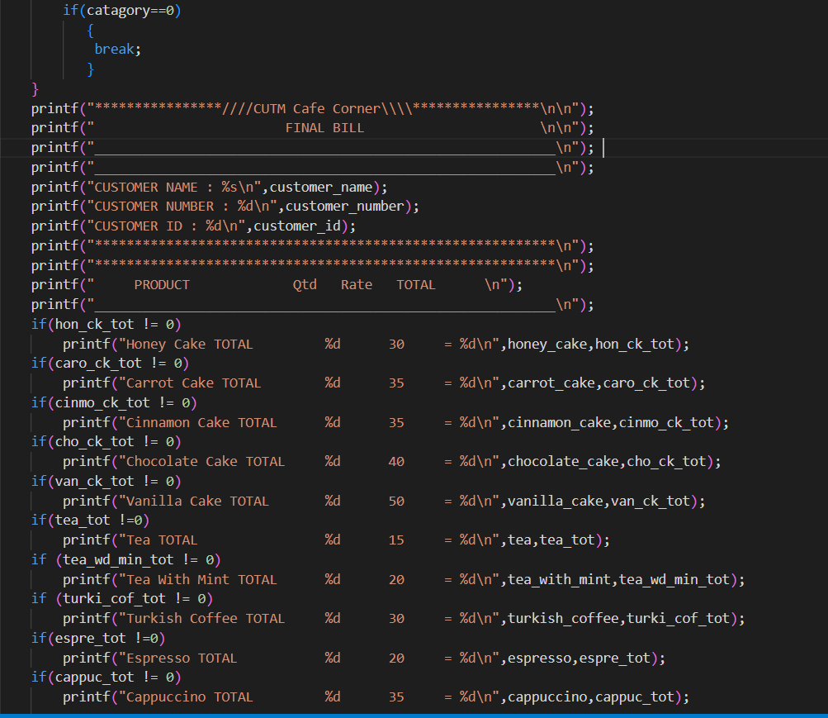
CONT :-

Slide 11
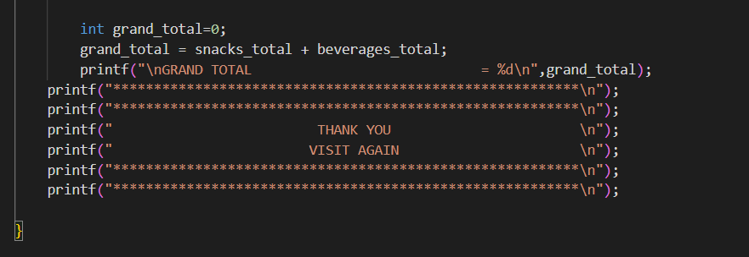
CONT :-

Slide 12
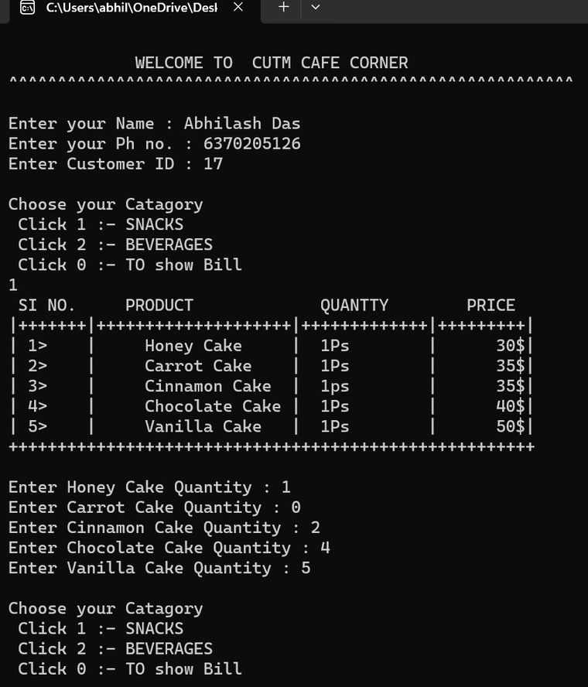
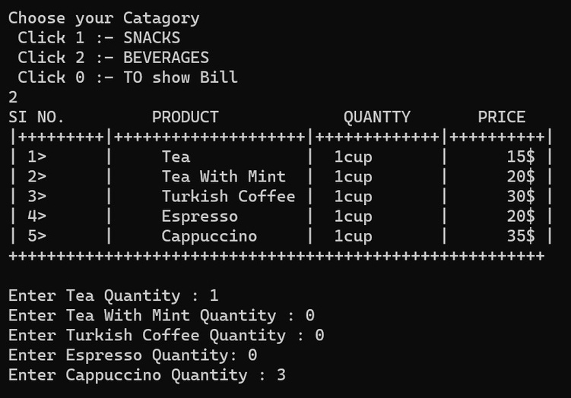
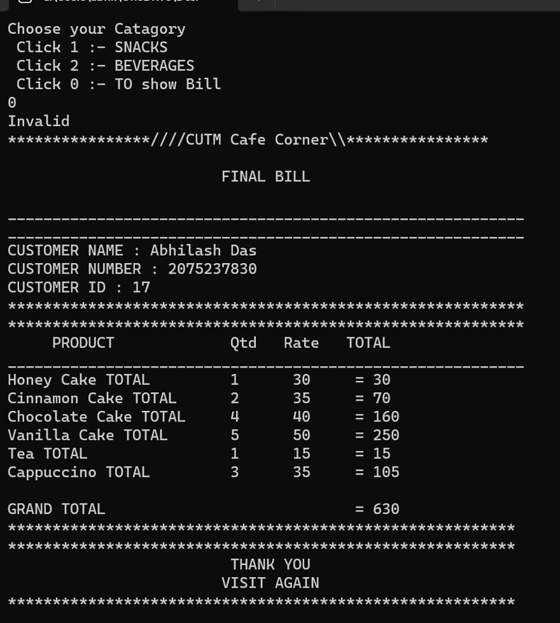
OUTPUT :-

Slide 13
Thank
You!

